Slide 1
Ce443 : Cloud computing
Unit -3
Cloud storage is a cloud computing model that stores data on the Internet through a cloud computing provider who manages and operates data storage as a service

Slide 2
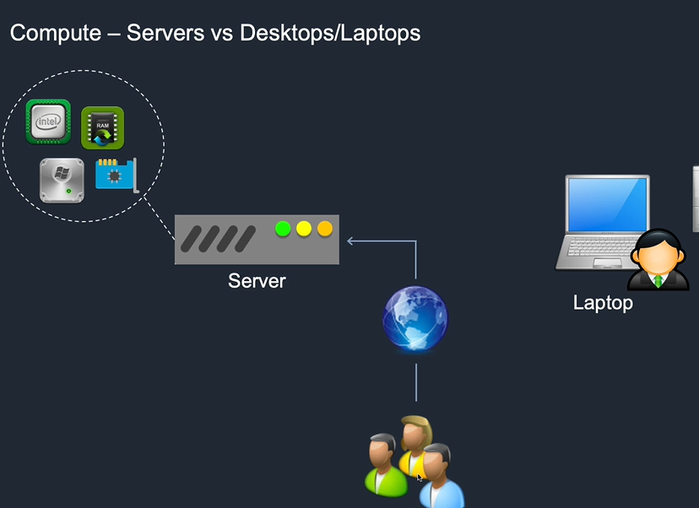
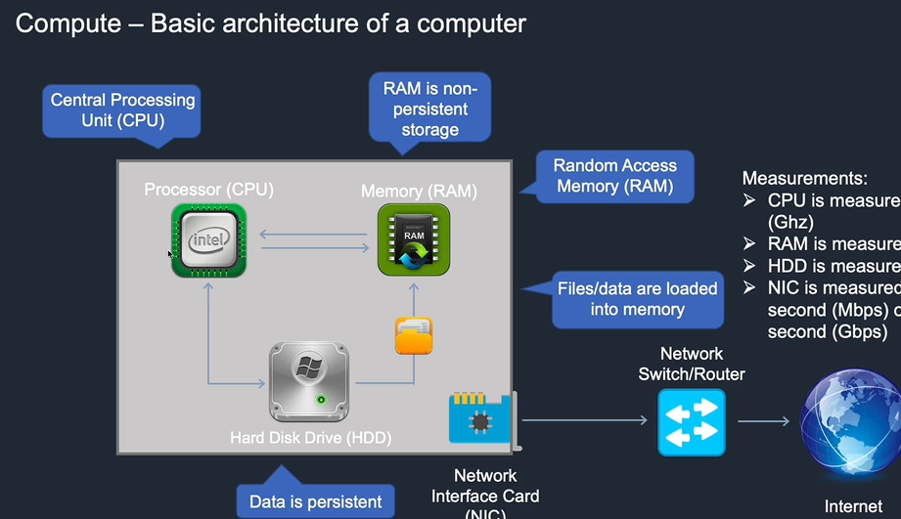
The Building Blocks of Cloud Computing
Compute

Slide 3
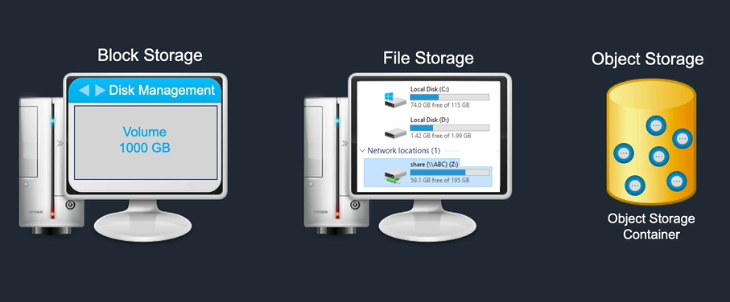
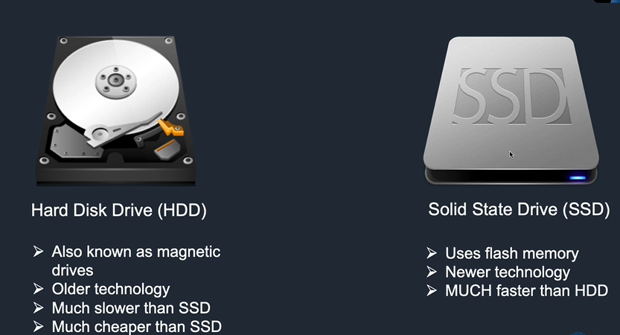
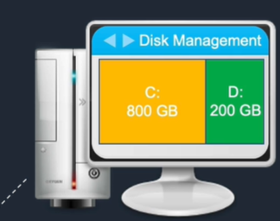
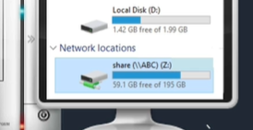
The Building Blocks of Cloud Computing
Storage

Slide 4
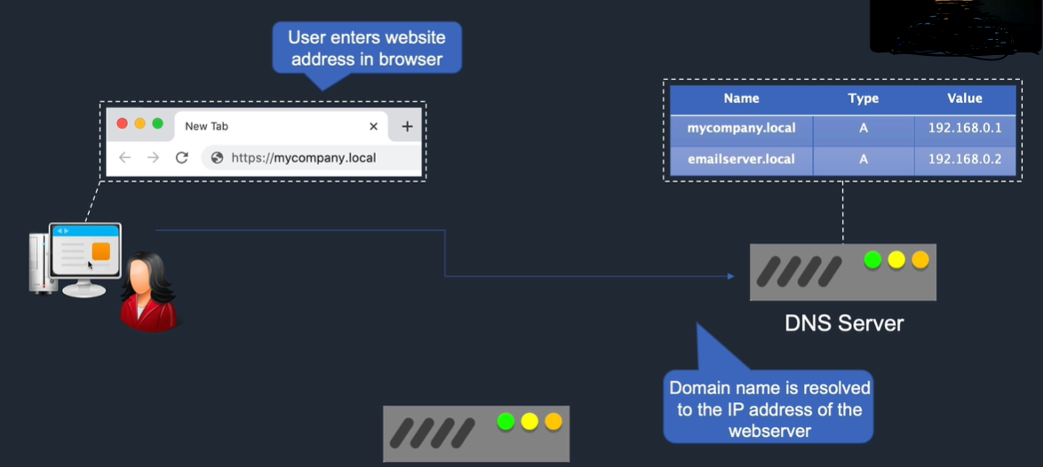
The Building Blocks of Cloud Computing
IP Addressing Primer

Slide 5
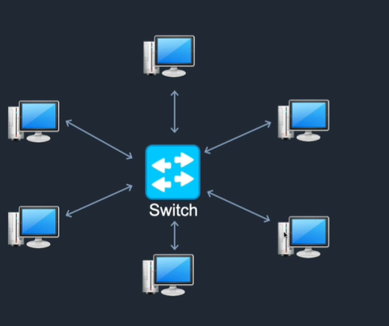
The Building Blocks of Cloud Computing
Networking – Router and Switches

Slide 6
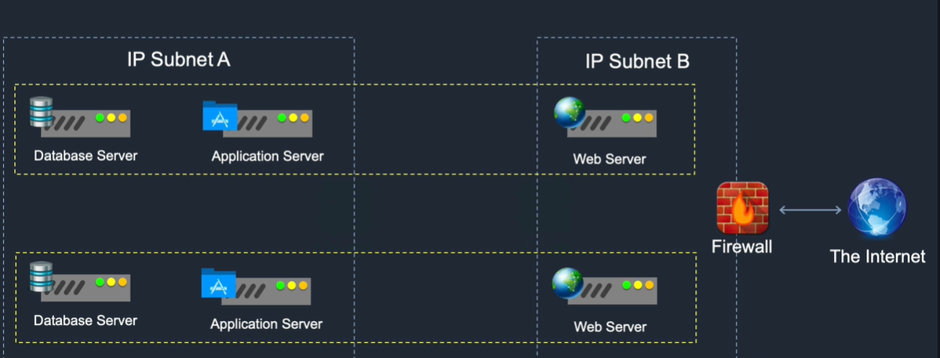
The Building Blocks of Cloud Computing
Networking – Firewalls

Slide 7
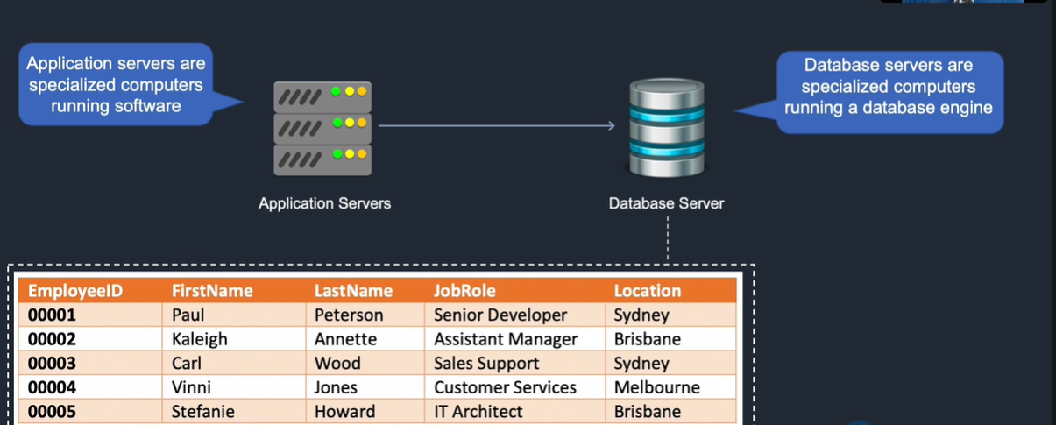
The Building Blocks of Cloud Computing
Database

Slide 8
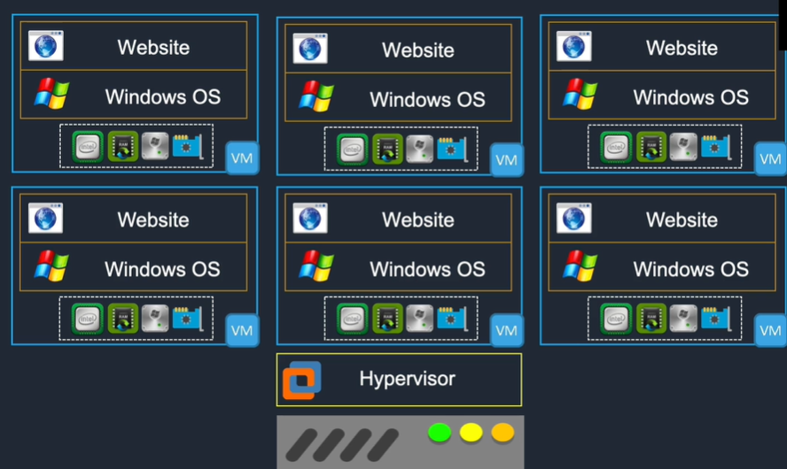
The Building Blocks of Cloud Computing
Virtualization

Slide 9
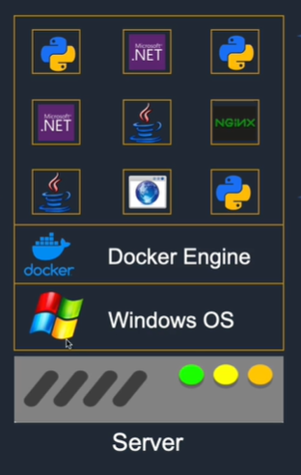
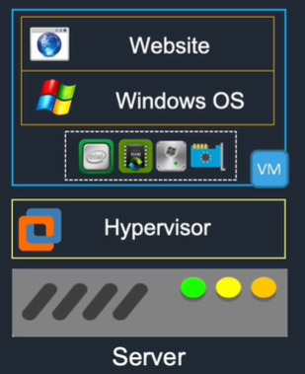
The Building Blocks of Cloud Computing
Docker container

Slide 10
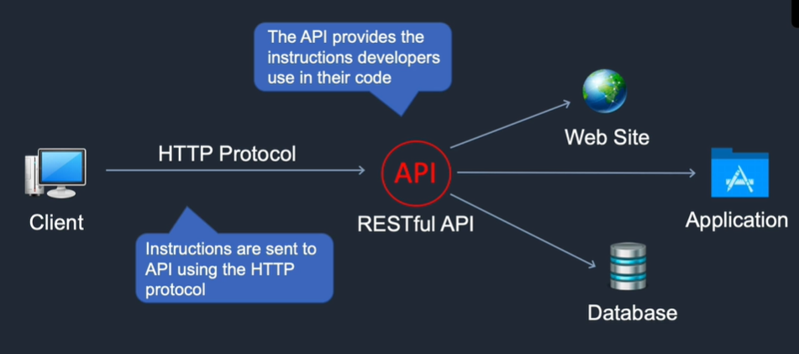
The Building Blocks of Cloud Computing
APIs (Application Programming Interfaces)

Slide 11
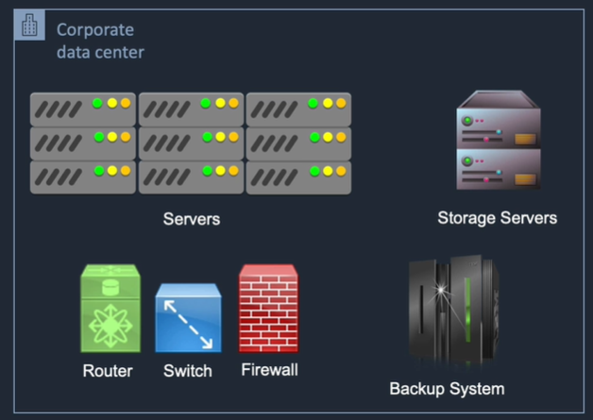
Traditional IT / Legacy IT

Slide 12
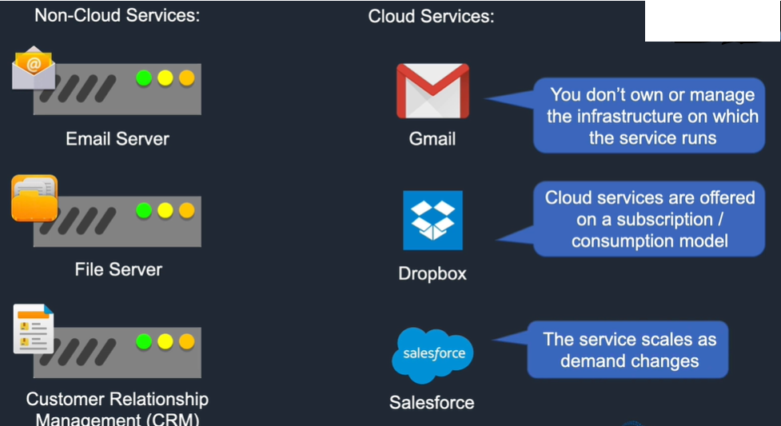
What is cloud computing

Slide 13
“ Cloud computing overlaps some of the concepts of distributed, grid and utility computing, however it does have its own meaning if contextually used correctly “
This cloud model promotes availability and is composed of five essential characteristics, three service models, and four deployment models.

Slide 14
Key characteristics
Name | Description
On-demand, self-service | A user can consume cloud resources, as needed, automatically and without human interaction
Broad network access | Capabilities are available over the network using standard mechanisms. Can be the internet or a wide area network (WAN)
Resource pooling | The provider resources are pooled and serve multiple
Rapid elasticity | Capabilities can scale “elastically” based on demand
Measured service | Resource usage is monitored and metered

Slide 15
Deployment Models Service Model
Private cloud SaaS
Community cloud PaaS
Public cloud IaaS
Hybrid cloud

Slide 16
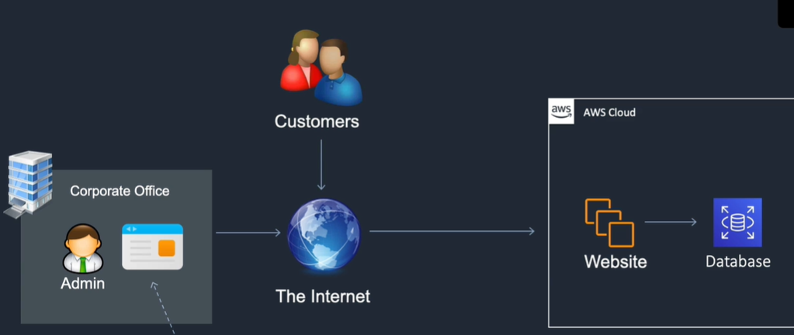
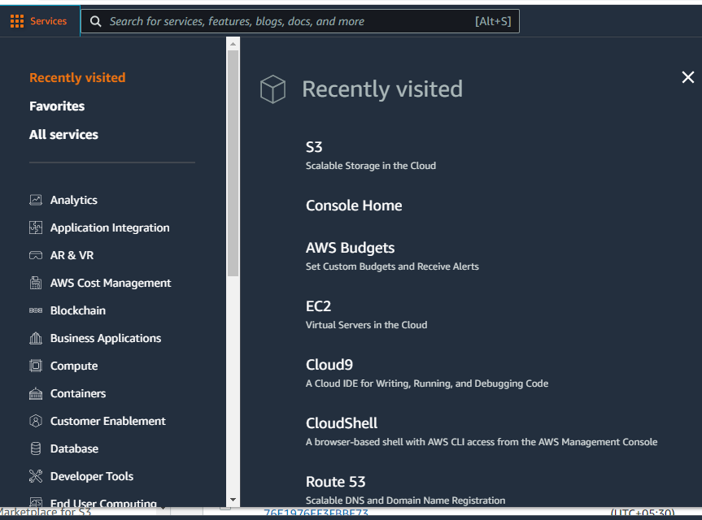
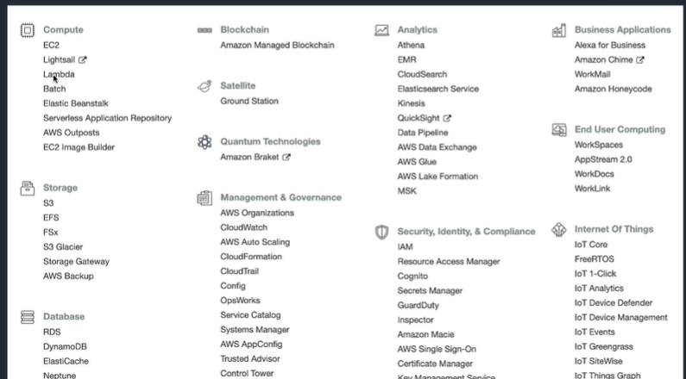
Launching cloud services: Management Console

Slide 17
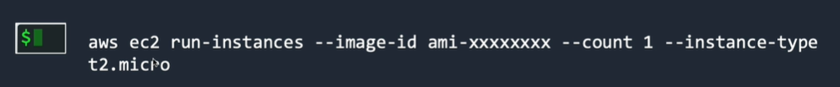
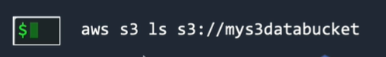
Launching cloud services: Command line

Slide 18
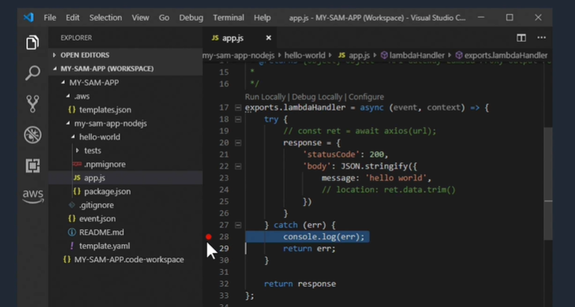
Launching cloud services: SDK

Slide 19
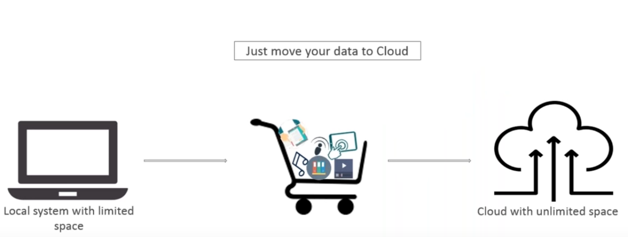
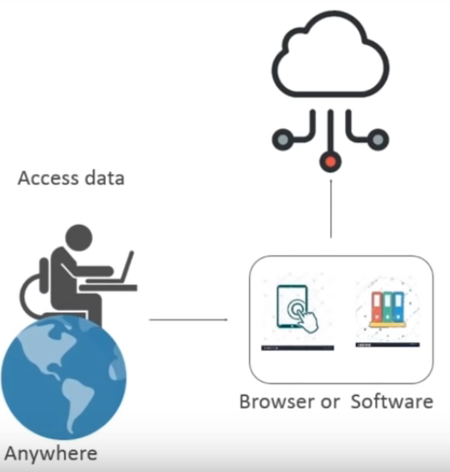
Why Cloud? ……
Cloud computing is:
Storing data/applications on remote severs
Processing data/applications from servers
Accessing data/applications via internet

Slide 20
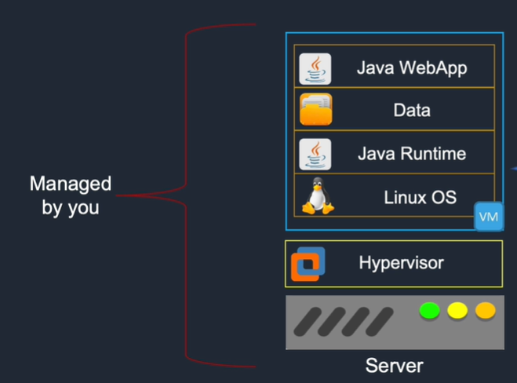
Cloud service models – Private Cloud

Slide 21
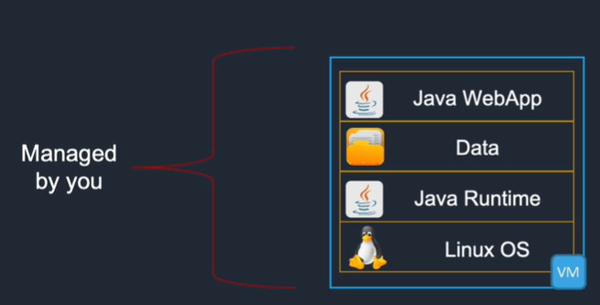
Cloud service models – Infrastructure as a service (IaaS)
Examples:
Amazon elastic compute cloud (EC2)
Azure virtual machines
Google compute engine

Slide 22
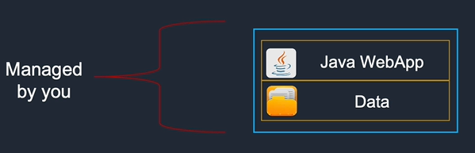
Cloud service models – Platform as a service (PaaS)
As a developer you don’t wont to mange infrastructure ; you just want to deploy code
Examples:
AWS elastic Beanstalk
Azure WebApps
Google Compute app engine

Slide 23
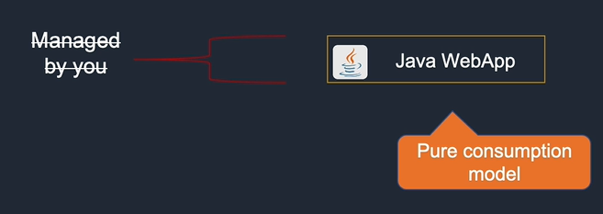
Cloud service models – Software as a service (SaaS)
The application is provided to you. All you need to do it just login with credentials and use it you don’t need to manage , configure and setup.
Examples:
Google apps
Saleforce.com
Zoom

Slide 24
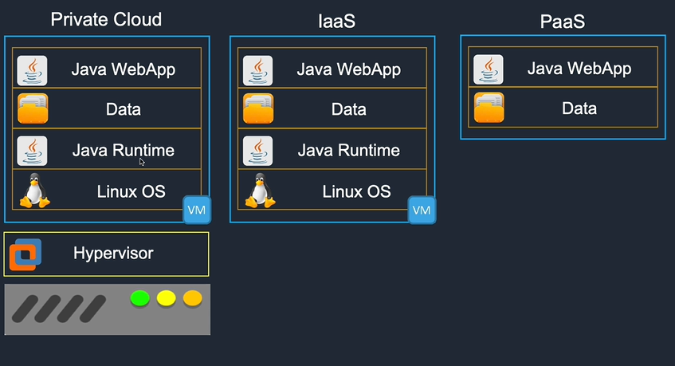
SaaS
You simply consume the service [e.g. login credentials]
little responsivity + little control
You mange everything + greater responsibilities + greater control
You mange from the virtual server upwards
You simply upload your code/data to create your application [No any VM management]

Slide 25
Cloud Deployment Models
Name | Description | Examples
Private cloud | An enterprise deploys their own infrastructure and applications into their own data centers | VMWare, Microsoft, RedHat, OpenStack
Public cloud | The IT services that you consume are hosted and delivered from a third-party and accessed over the Internet | AWS, Microsoft Azure, Google Cloud Platform
Hybrid cloud | A combination of on-premises, private cloud and cloud services are consumed
Multicloud | Usage of two or more public cloud at a time and possibly multiple private cloud

Slide 26
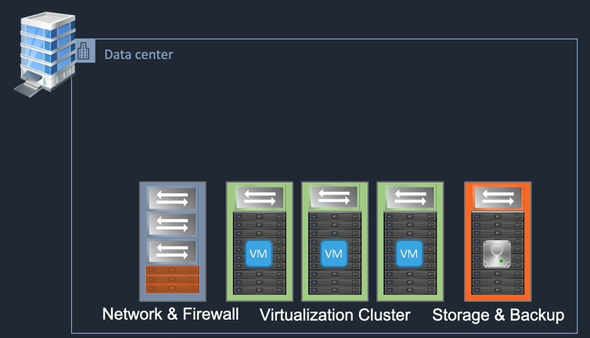
Deployment Models – Private Cloud
cloud management software layer

Slide 27
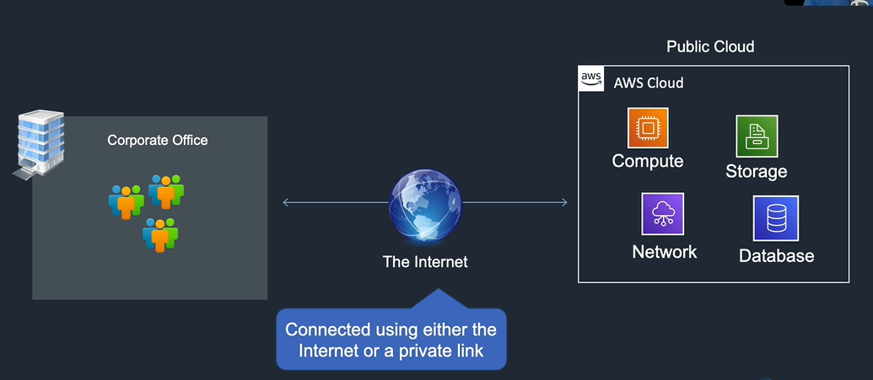
Deployment Models – Public Cloud

Slide 28
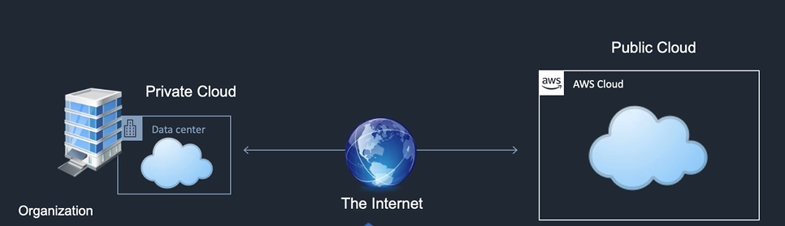
Deployment Models – Hybrid Cloud

Slide 29
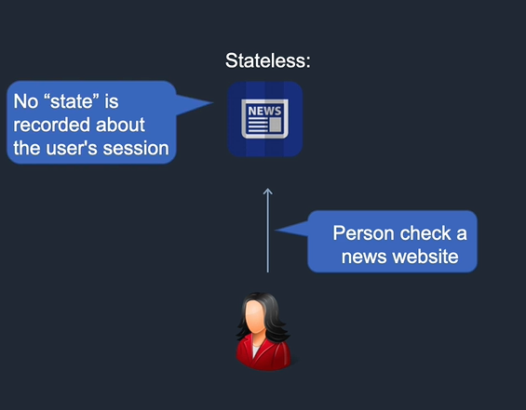
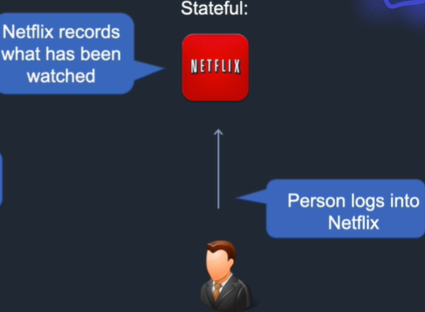
Stateful vs Stateless Applications

Slide 30
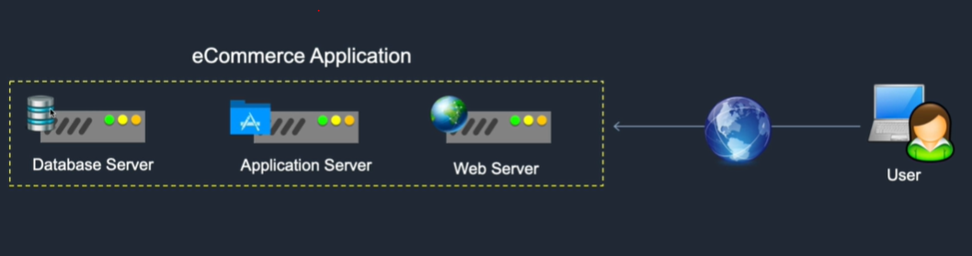
Stateful vs Stateless Applications

Slide 31
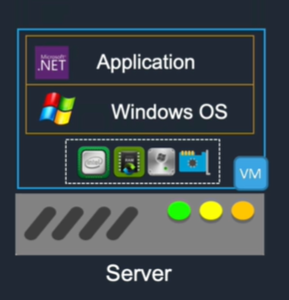
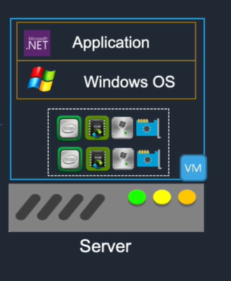
Scalability and Elasticity: Scaling Up

Slide 32
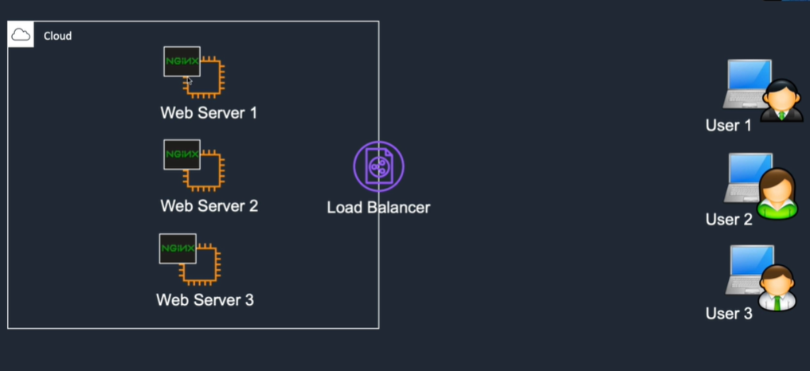
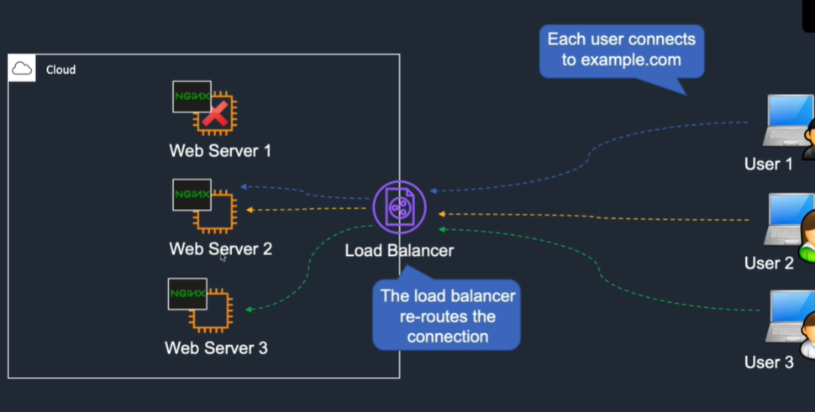
Load balancing

